Slide 1

Final Presentaion
Customer Segmentations
10th Aug 2021

Slide 2
Background – Customer Segmentation
Objective: XYZ bank wants to roll out Christmas offers to their customers. But Bank does not want to roll out same offer to all customers instead they want to roll out personalized offer to particular set of customers. If they manually start understanding the category of customer then this will be not efficient and also they will not be able to uncover the hidden pattern in the data ( pattern which group certain kind of customer in one category). Bank approached ABC analytics company to solve their problem. Bank also shared information with ABC analytics that they don't want more than 5 group as this will be inefficient for their campaign.
Contents of this Presentation
Data Exploration and Cleaning
Analysis
Modeling
Evaluation
Recommendations

Slide 3
Data Exploration
Final Dataset
85023 observations
9 columns
Actions Performed
Handling outlies and null values
Z Score Method
Mean method
Changing Appropriate dtypes
Changing column names and observations from Spanish to readable English
Selected appropriate features for modeling

Slide 4
NA Values and Outliers
Few observations which have null values are overlapping, i.e same records have missing values in all columns have been removed.
The columns ult_fec_cli_1t and conyuemp have 99% null values so the best action would be to drop these two columns. The renta column represents the gross income of the family, and has about 17% of null values, these null values can be replaced by the average of column. There are null values in other columns but they amount to around 1% of the dataset so I have decided to remove them from the dataset.
Replaced nulls in renta column with average value
Outliers in gross income and age column have been identified using a box plot and have been removed based on their z-score.
Features are selected based upon the relevance of the column and the type of data.Most of the binary data is removed only important columns are retained as binary data doesnt work well with Clustering algorithms.

Slide 5
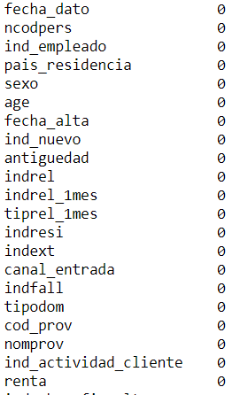
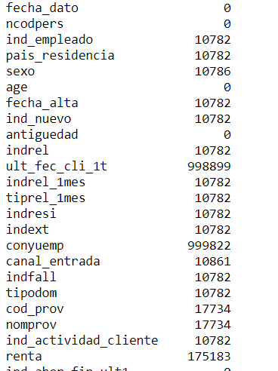
NA Values
Before
After

Slide 6
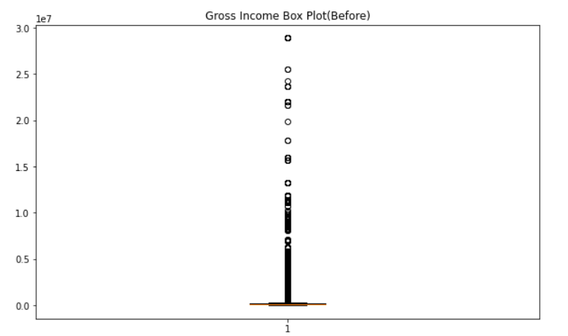
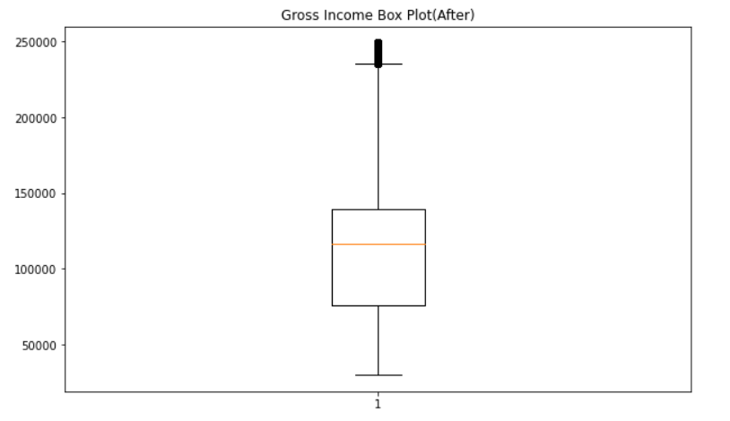
Outliers(Using z-score)

Slide 7
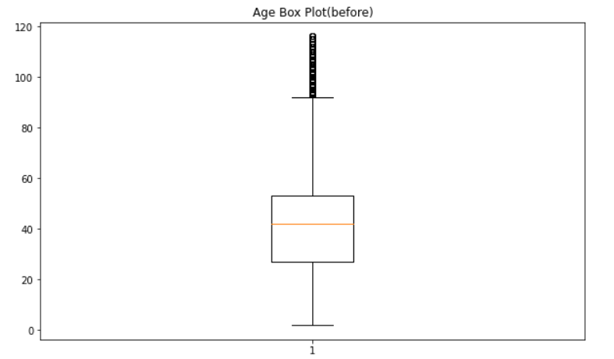
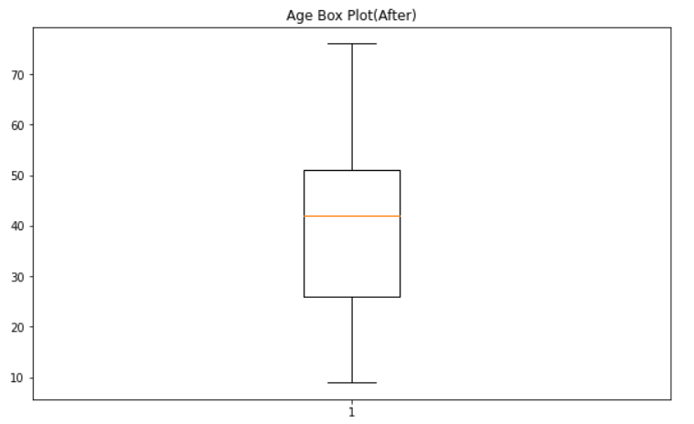
Outliers(Using z-score)

Slide 8
General Observations
Employee Index values
N : 981145 A : 285 F : 282 B : 385 S : 2
Country values
ES : 982089 IT : 4 DE : 2 BO : 2 PY : 2
Customer Type values
1 : 982095 2 : 2 3 : 2
These column will not be very useful in clustering, as they will introduce bias, and can thus be removed.

Slide 9
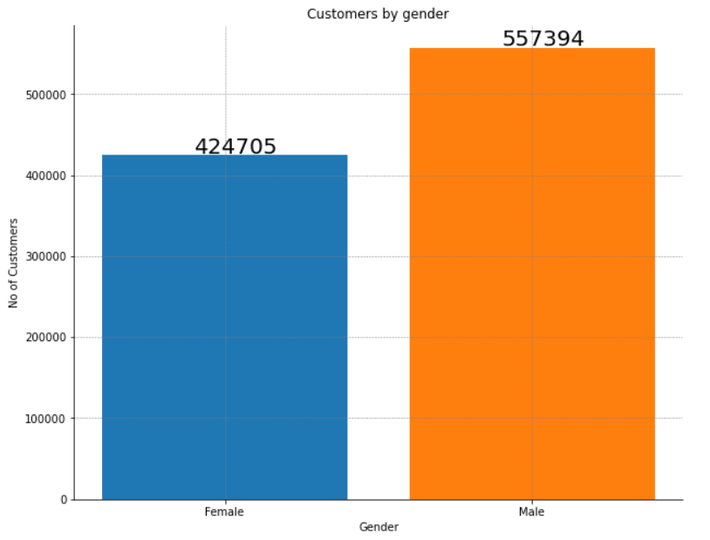
General Observations

Slide 10
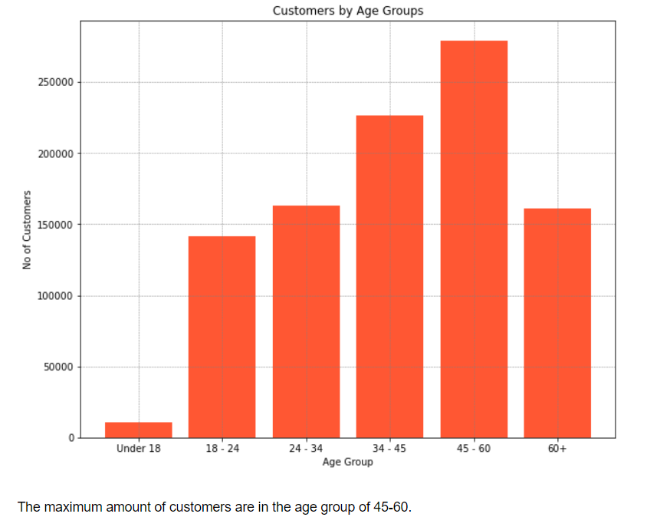
General Observations

Slide 11
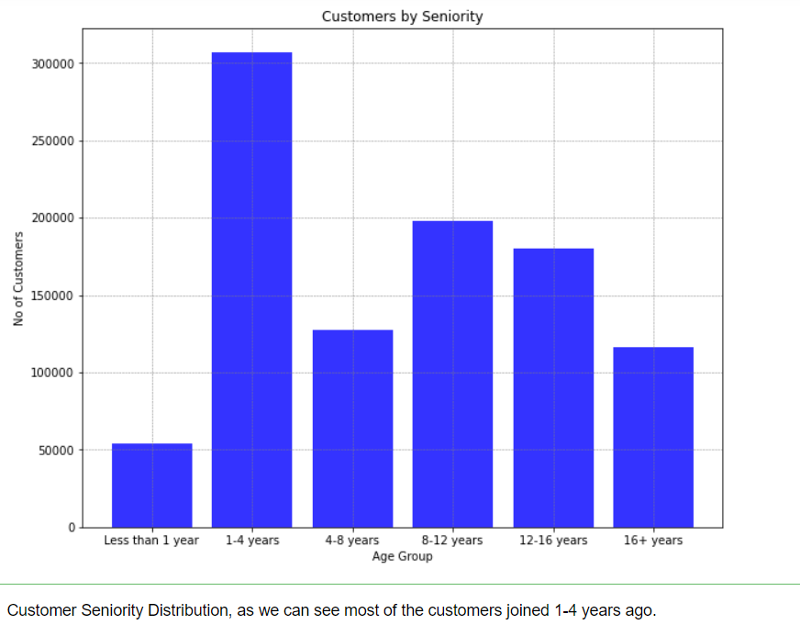
General Observations

Slide 12
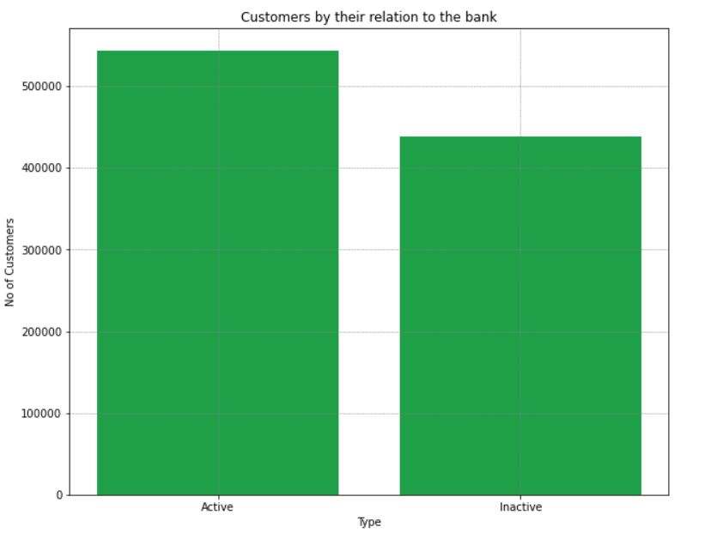
General Observations

Slide 13
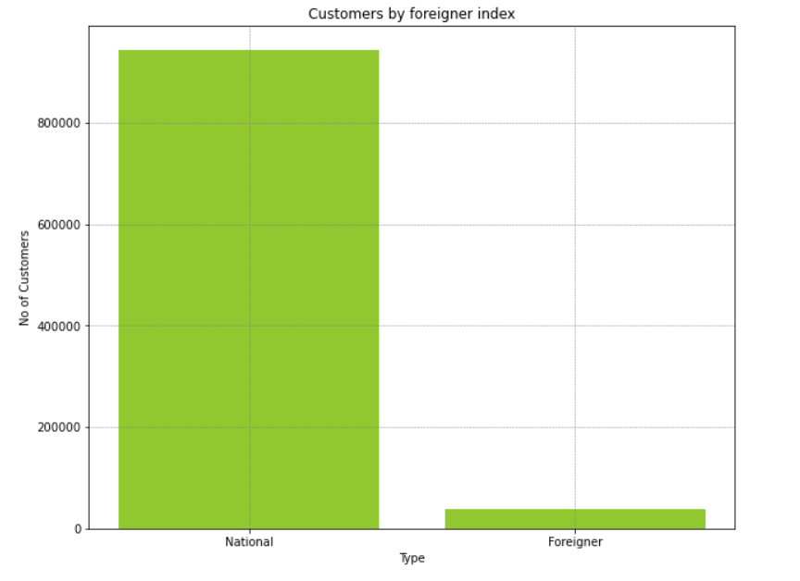
General Observations

Slide 14
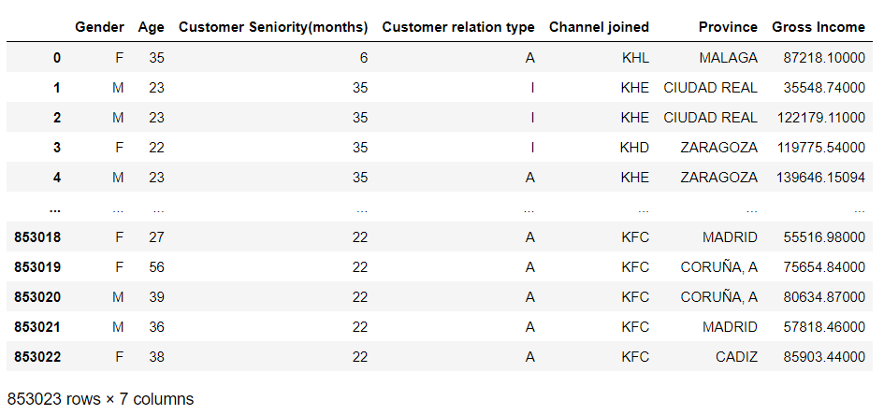
Modeling
Final Dataset looks something like

Slide 15
Modeling
For this particular problem we have to use the K-means clustering algorithm for determining the group of each of the customer in the dataset.
K-means is a clustering technique which calculates the distance between observations and groups them into clusters by iterative technique.
K-means works very well with data of such sort.
For K-means we have to convert all the variables into numeric values
This can be done by using the Label encoder this is shown next slide.

Slide 16
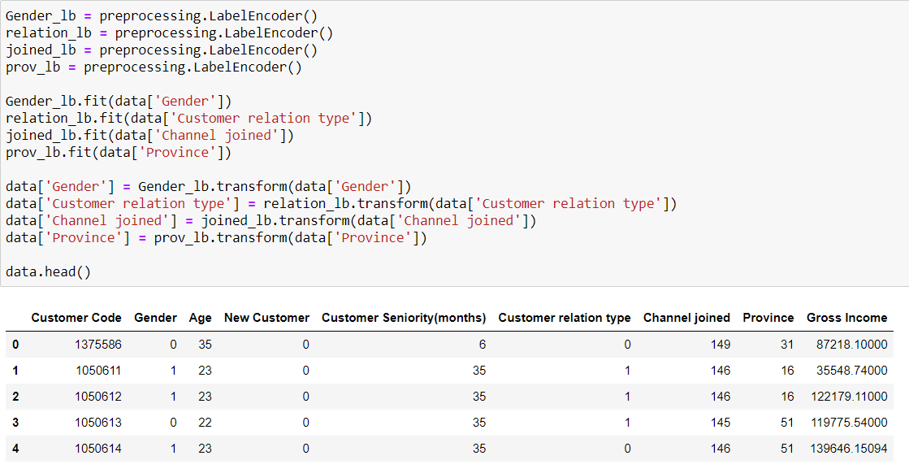
Modeling(Encoding into numeric data)

Slide 17
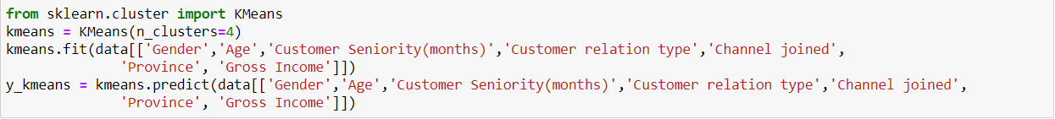
Modeling(Creating the model)
Model has been created and predictions have been made

Slide 18
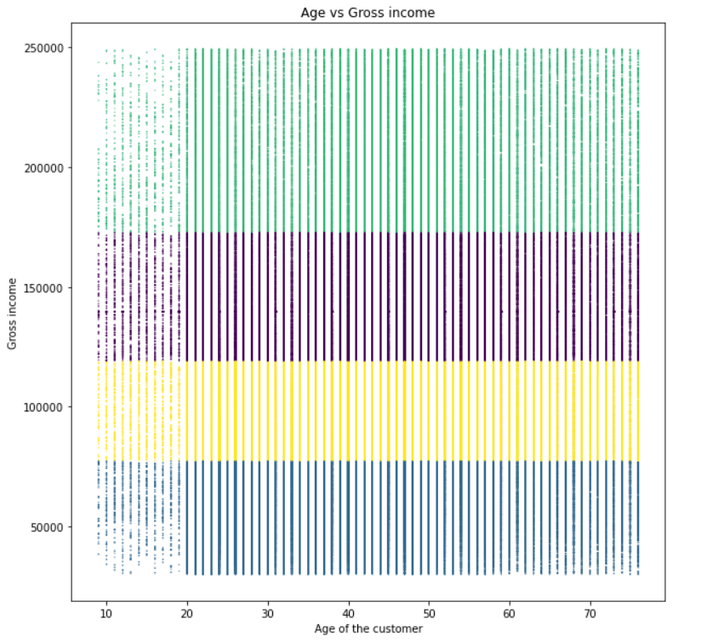
Modeling(Visualization)

Slide 19
Modeling
The model has been created successfully and fit on the particular dataset and is able to distinguish customers into 4 segments
The graph shows the clusters in relation with Gross Pay of the customer and Age of the customer.
The model has created clusters based on the Gross pay of the customers and as our client is a bank this makes sense to provide targeted advertisements for the customers.
Next step is to evaluate the model and find the optimal solution this has been shown in the next slide.

Slide 20
Modeling(Evaluation)
To evaluate the model we use distortion method to calculate the distortion for different values of K and then find the Elbow method to find the optimal value of K
We get the following distortion for each value of K.
1 : 39751.68823745483 2 : 21745.029006819208 3 : 14706.331814293326 4 : 10326.245693782306 5 : 8968.418520063888 6 : 6863.19407177712 7 : 6005.101307798649 8 : 5296.478246176699 9 : 4646.272938309745

Slide 21
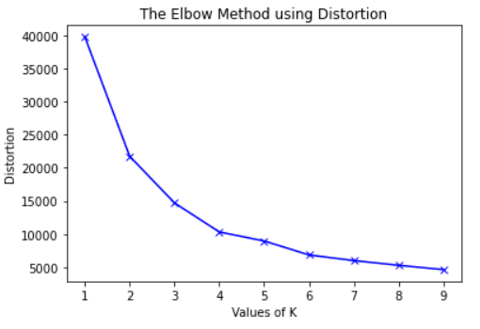
Modeling(Evaluation)
The optimal value of K is 4 as seen from the graph above.

Slide 22
Recommendation
Finally our model is ready and has been evaluated.
By evaluating different models we have found that 4 clusters perform the best in such dataset.
The model determined that the clusters based on mainly the gross income of the customers and the bank should create better targeted advertisements using this cluster information

Slide 23

Thank You

